Slide 1

Structured Query Language (SQL)
Part 1. Relational Data Model
Possible Connection Methods

Slide 2
Topics for Today
About the Relational Data Model: Key Concepts of RDM
Constraints in Relational Databases
Introduction to SQL DDL
Possible Methods of Connecting to a Database

Slide 3
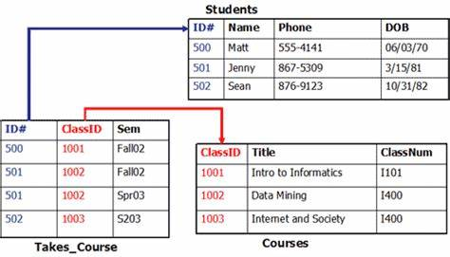
Relational Data Model (1/5)
Developed in the 1970s
Relational Database Management Systems (RDBMS) are based on this model
Eliminates many shortcomings of previously existing data models
One of the most widely used data models

Slide 4
Relational Data Model (2/5)
In the Relational Data Model (RDM), a database consists of tables
One row = an instance of an entity
The Students table contains records about students, with each row corresponding to a single student
RDM allows controlling the level of data redundancy
Storing subject records together with student records would result in many duplicates
Instead, records about students and subjects can be replaced with their keys, and the associations can be stored separately

Slide 5
Relational Data Model (3/5)
Normalized and Denormalized Databases
This is an example of a normalized database
Operational databases are usually more normalized, as they focus on efficient writing and maintaining data integrity
Analytical databases may store data in a denormalized format to speed up reading operations
Think about how to retrieve information about multiple students and the subjects they are enrolled in

Slide 6
Relational Data Model (4/5)
Involves working with data in the form of tables and records
Why this name?
The data within R1 is a subset of the Cartesian product of all possible values of attributes A and B => R1 is a relation
Отношения
A
B
R1 ( )
A
X
B
The data within R2 is a subset of A × C × D
B
C
D
R2 ( )
A
C
D
X
X

Slide 7



Relational Data Model (5/5)
The data model consists of these components:
Data Definition Language (Schema) (DDL)
Tables and Views
Data Manipulation Language (DML)
Domain Calculus
Tuple Calculus
Relational Algebra
Integrity Constraints (DDL)
Various data validation rules

Slide 8
Choose the correct statement
In normalized databases, there may be more tables, and retrieving data requires fewer operations.
In normalized databases, there may be fewer tables, and retrieving data requires fewer operations.
In normalized databases, there may be more tables, and retrieving data requires more operations.

Slide 9
Terminology and Notations
Table (Relation) and Columns (Attributes):
driver(did, name, gender)
Fields (Columns, Attributes)
of a Table
Table name ( relation)
driver
Title
did | name | gender
1 | Jared | m
2 | Mary | f
3 | Linda | f
4 | Carol | f
5 | Fred | m
Data
Row (Tuple) with 3 Fields

Slide 10
Table (Relation) in the RDM
Key Requirements for a Relation:
Columns have unique names
No multivalued columns
Data is stored as unordered tuples
All tuples are unique
Each column corresponds to a single data type
The model does not consider the physical organization of data

Slide 11
Table (Relation) in the RDM
Features of a Table in a Database:
Columns have unique names
Modern databases support complex data types
Records are stored in data files
Uniqueness is not a mandatory property
Each column corresponds to a single data type
DBMS can perform significantly more operations than originally defined in the relational data model

Slide 12
A Table (Relation) is typically associated with real-world objects and their attributes.
class(clsid, capacity, bags, transmission) – class of car
driver(did, name, gender) – driver (obviously)
cls_id | capacity | bags | transmission
A | 2 | 1 | m
B | 2 | 1 | a
C | 5 | 3 | m
D | 5 | 3 | a
d_id | name | gender
1 | Jared | m
2 | Mary | f
3 | Linda | f
4 | Carol | f
5 | Fred | m

Slide 13
Differences in Terminology
Relational Model (Theory)
Database (Implementation)
Requirements (Database Design)
Entity
Attribute
Entity Instance
Relation
Attribute
Tuple
Table
Column (Field)
Row (Record)

Slide 14
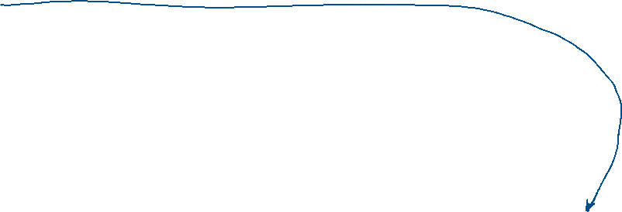

Primary Key (1/2)
Candidate Key:
A set of attributes that uniquely identifies a single row
Minimal
Primary Key:
A candidate key
One of the keys chosen by the developer
class(clsid, capacity, bags, transmission)
driver(did, name, gender)

Slide 15



Primary Key (2/2)
Knowing the value of the primary key allows for quick retrieval of a row in the table. If the key is composite, the search will need to use multiple columns simultaneously.
The primary key is associated with an index, which is created and maintained by the DBMS.
Analytical databases may not have primary keys.

Slide 16
Foreign Key Concept (1/3)
Foreign keys are references to other rows in the same table or in different tables.
How can a class be added to the table?
Each car belongs to a single class
PK
clsid | capacity | bags | trans.
A | 2 | 1 | m
B | 2 | 1 | a
C | 5 | 3 | m
D | 5 | 3 | a
PK
cid | make | year | mileage
1 | nissan | 2017 | 85000
2 | peugeot | 2017 | 79000
3 | peugeot | 2017 | 56000
4 | renault | 2018 | 28000
5 | renault | 2019 | 5500
6 | peugeot | 2019 | 2000
7 | nissan | 2019 | 1500

Slide 17
Foreign Key Concept (2/3)
You can add a reference to the class in the table with cars.
Valid values are the primary key of the classes table.
You can also reference a column (or columns) with a uniqueness constraint. (Unique key)
PK
clsid | capacity | bags | trans.
A | 2 | 1 | m
B | 2 | 1 | a
C | 5 | 3 | m
D | 5 | 3 | a
PK
cid | make | year | mileage
1 | nissan | 2017 | 85000
2 | peugeot | 2017 | 79000

Slide 18
The Concept of a Foreign Key (3/4)
A Foreign Key (FK) in the child (dependent) table is a reference to the Primary Key (PK) of the parent table.
If there is no PK (or unique constraint), the reference cannot be established.
PK
PK
Relationship: car belongs to a class
clsid | capacity | bags | trans.
A | 2 | 1 | m
B | 2 | 1 | a
C | 5 | 3 | m
D | 5 | 3 | a
cid | make | year | mileage | clsid
1 | nissan | 2017 | 85000 | B
2 | peugeot | 2017 | 79000 | A
3 | peugeot | 2017 | 56000 | B
4 | renault | 2018 | 28000 | D
5 | renault | 2019 | 5500 | A
6 | peugeot | 2019 | 2000 | D
7 | nissan | 2019 | 1500 | C
Parent Table
Dependent
Table

Slide 19
The Concept of a Foreign Key (4/4)
A Foreign Key (FK) in the child (dependent) table is a reference to the Primary Key (PK) of the parent table.
If there is no PK (or unique constraint), the reference cannot be established.
PK
PK
FK
cls_id | capacity | bags | trans.
A | 2 | 1 | m
B | 2 | 1 | a
C | 5 | 3 | m
D | 5 | 3 | a
c_id | make | year | mileage | cls_id
1 | nissan | 2017 | 85000 | B
2 | peugeot | 2017 | 79000 | A
3 | peugeot | 2017 | 56000 | B
4 | renault | 2018 | 28000 | E
cls_id the car table can only contain values that exist in the related primary key.

Slide 20
What term refers to a table?
Relationship
Connection
Relation
Field

Slide 21
Select all correct statements
A foreign key can be composite
A foreign key must be numeric
A foreign key can reference any column in another table

Slide 22
Referential Integrity Support in RDBMS (1/2)
A database server can check, intervene, and prevent data integrity violations in the following cases:
Attempting to insert a value into a foreign key that does not exist in the referenced table (in the corresponding primary key or unique constraint)
Attempting to delete a record referenced by a foreign key
Attempting to modify a key in a record that is being referenced
A condition validated by a trigger is violated

Slide 23
Referential Integrity Support in RDBMS (2/2)
You can additionally configure the handling of the following situations:
Attempting to delete a record referenced by a foreign key
Attempting to modify a key in a record that is being referenced
Supported Actions:
Propagate changes to dependent tables (Cascade)
Replace the value in the foreign key with a constant
Raise an error

Slide 24









Delete
Update

Slide 25

Possible methods of connecting to a PostgreSQL database.

Slide 26
GUI – Dbeaver CE
A universal client for working with various databases.
It supports connections to PostgreSQL and many other DBMSs, as well as SQLite.
It has convenient tools for data import and export.

Slide 27
GUI – pgAdmin
It can be installed separately.
It contains tools for writing queries and visualizing data structure.
There is a built-in query execution plan visualizer.
It works with PostgreSQL databases.

Slide 28
Connecting using the command-line tool.
psql allows connecting to a PostgreSQL database.
psql comes with the server and can be found in the bin folder.
Connecting using psql:
psql -h host -U user
psql -h host -U user -p port
psql -h host -U user -p port -d database_name
host – the address or name of the server you want to connect to.
The default port is 5432. Multiple PostgreSQL servers can run on the same host.
To exit psql, press Ctrl+C or type quit or /q.
You can directly connect to the desired database. By default, it connects to the postgres database.

Slide 29
Connecting using the command-line tool.
Useful psql commands:
/q – exit
/c database_name – connect to a database
/d – list all tables in the database
/d table_name – show all fields of a table
/l – list databases on the server
/dn – list schemas in the database
/dv – list all views
... and many other commands.

Slide 30

Introduction to SQL DDL
Data definition language

Slide 31
SQL
The first standardized (ANSI) version – 1986
Current version – SQL:2023
The language consists of several parts:
DDL – Data Definition Language
DML – Data Manipulation Language
DCL – Data Control Language
TCL – Transaction Control Language

Slide 32
SQL
The first standardized (ANSI) version – 1986
Current version – SQL:2023
The language consists of several parts:
DDL – Data Definition Language
DML – Data Manipulation Language
DCL – Data Control Language
TCL – Transaction Control Language
Knowledge of DDL is needed to:
Understand the structure of tables
Be able to modify database objects
Create database objects, such as tables

Slide 33




















Database Objects We Will Work With
Schema
Table
View
Column
Constraint
Functions and Procedures
Users and Roles

Slide 34
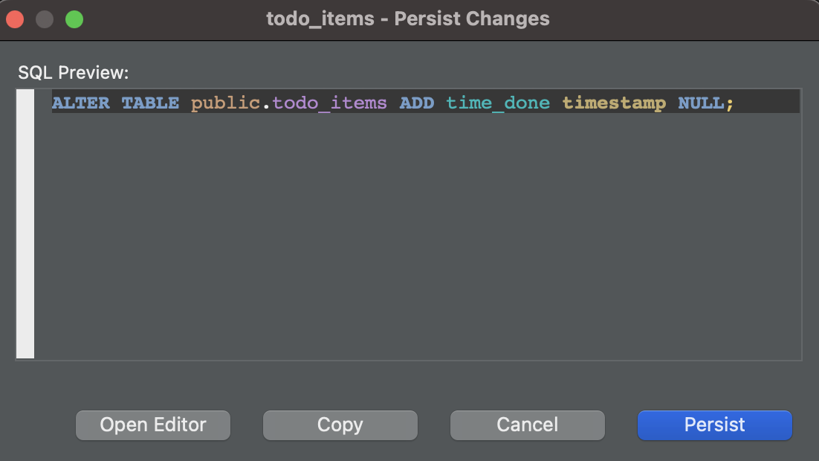
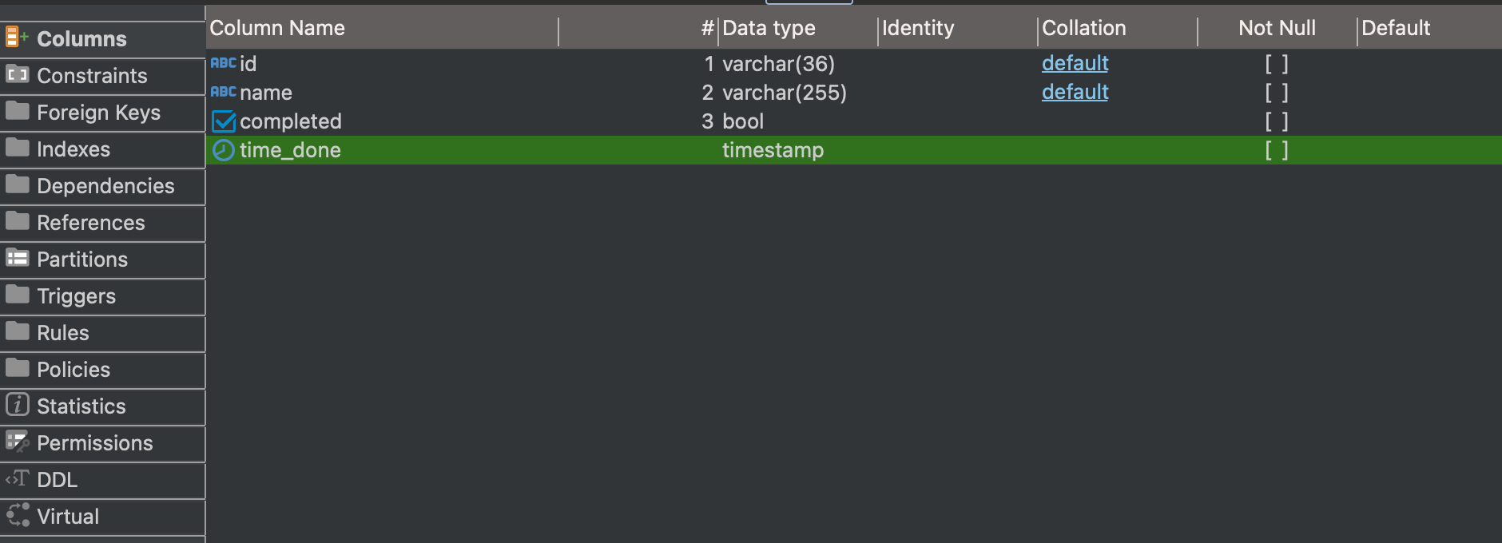
DDL and Graphical user interface
You can create tables in the GUI
The editor will generate queries as SQL DDL scripts and send them to the server
In DBeaver CE, you can view these queries before saving changes

Slide 35
Working with a Database via Client Software
To connect, you need to know the connection parameters
After connecting, you will be able to work with the database and its nested objects
Database Object Hierarchy =>
The schema groups database objects
A table stores data, while a view (typically) provides access to table data
Server
View
Schema
Table
Column
Constraint
Column
...

Slide 36
Key DDL Instructions
Create (add) a database object
CREATE
Modify a database object
ALTER
Delete a database object
DROP
Delete all data from a table that is not referenced by other tables
TRUNCATE TABLE
The syntax may vary depending on the platform.

Slide 37
Question
How do you understand the following phrase?
A table that is not referenced by other tables.

Slide 38
How to create and delete a database?
Create database my_database;
Drop database my_database;

Slide 39
How to create a table using SQL?
Basic syntax:
CREATE TABLE (
Field Definition, …
Constraint , …
)
The mandatory part of a column definition includes the name and type.
<field_name> <data_type> [null|not null] [default <value>]
Also, a compact definition of a field with constraints is possible.

Slide 40
Naming Objects in Postgres
Before starting database development, it is advisable to agree with all team members on the naming conventions for database objects.
It is recommended to use snake_case for naming tables and columns. Avoid using mixed case. Instead, stick to lowercase letters only.
Names with MixedCase will always need to be written in double quotes.
Unquoted names are converted to lowercase. Therefore, buiding_id and Building_Id are treated as the same column. However, "Building_Id" is considered a different column.

Slide 41
Example script for creating a table:
-- Single-line comment about the table
/* Multi-line comment
describing the table */
CREATE TABLE messages(​
msg_id bigint not null primary key,​
sender_name varchar(25) NOT NULL,​
receiver_name varchar(25) NOT NULL,​
msg_text varchar(300) NOT NULL,​
sent_on timestamp NOT NULL default (now())​,
picture_path varchar(2000) NULL
)​;

Slide 42
Attention
If you execute this script twice in a row, the second attempt will result in an error.
Why?
CREATE TABLE messages(​
msg_id bigint NOT NULL PRIMARY KEY,​
sender_name varchar(25) NOT NULL,​
receiver_name varchar(25) NOT NULL,​
msg_text varchar(300) NOT NULL,​
sent_on timestamp NOT NULL default (now())​,
picture_path varchar(2000) NULL
)​;

Slide 43
Commonly Used Column Properties (1/2)
A sequence allows generating a new field value when inserting a new row. The initial value and increment step can be configured.
driver_id int GENERATED ALWAYS AS IDENTITY PRIMARY KEY

Slide 44
Commonly Used Column Properties (2/2)
A default value allows populating a field if no value is provided for that cell when adding a row to the table.
mileage int not null DEFAULT(0)
created_time timestamp not null default(now())

Slide 45
How to delete a table?
DROP TABLE messages;
If there are references to the table, an error will be returned.

Slide 46
How to quickly delete all data from a table?
TRUNCATE TABLE messages; Deletes all data from the table if there are no references to it.

Slide 47
How to add or remove a column?
ALTER modifies the structure of the table and column parameters.
The syntax depends on the required task.
Add column
ALTER TABLE messages ADD read_flag bool;
Delete column
ALTER TABLE messages DROP read_flag;

Slide 48
A complete description of DDL capabilities in Postgres can be found on the official documentation website.

Slide 49

Constraints in PostgreSQL RDBMS
Integrity Control

Slide 50
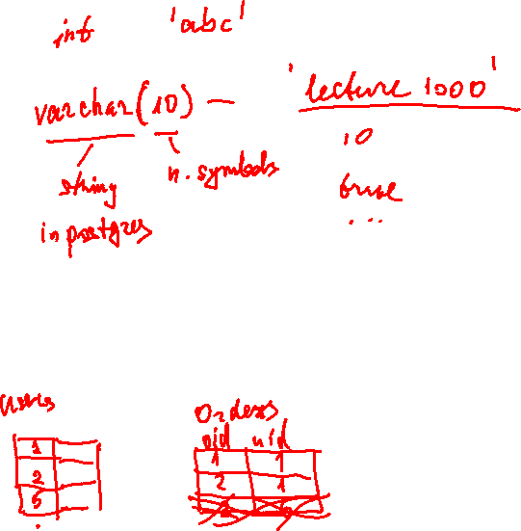
Constraints Supported in RDBMS
Available Constraints:
Data type compliance
Presence of a value in a field (null/not null)
Primary key (primary key)
Uniqueness (unique)
Foreign key (foreign key)
Check constraint using an expression (check)
Custom logic checks can also be implemented using triggers.
Violation of these constraints results in error messages.

Slide 51
Data type compliance
The DBMS checks the compliance of values with data types.
It will not be possible to write the text "ABC" into a numeric field.
Each column has a specific data type.
In SQL, there are specific rules for writing constants for different types.
Data type names may vary across different DBMSs.

Slide 52
Frequently Used Data Types in PostgreSQL
PostgreSQL supports many different data types. The main ones are as follows:
Integer Types:
int, bigint
Text Types:
varchar (max length), char (length), text (no length limit)
Numeric Types:
numeric (total digits, digits after the decimal point)
Floating Point Numbers:
float, real
Date, Time, and Interval Types:
date, timestamp, timestamptz, interval
Logical Type:
boolean
In PostgreSQL, there is no performance difference between the char(), varchar(), and text types.

Slide 53
Примеры значений разных типов
In SQL, you can explicitly specify the data type to which a value should be cast. Implicit type conversions are also supported.
Date and Time date, timestamp, timestamptz '2024-01-29'::date, '2024-01-30 09:01:05'::timestamp, cast('2024-01-29' as date)

Slide 54
Support for Undefined Values in Relational Databases
Some attributes may be optional to fill.
Absence of Value
Undefined Value
NULL is not an empty string in PostgreSQL.
NULL
Is not equal to '' (empty string)
Is not equal to 0 (zero)
Is not equal to ' ' (space)

Slide 55
Checking for the presence of a value in a field
Filling a field in a table can be:
Mandatory: Records with empty fields cannot exist. The DBMS will prevent such records from being created. In this case, the NOT NULL constraint is used.
A default value can be set for mandatory fields.
Optional: Skipping a value is denoted as NULL.

Slide 56
Support for Undefined Values in Relational Databases
In SQL, there are special syntax constructs for working with NULL values. If operations such as addition or subtraction involve a NULL value, the result will also be NULL.
Data integrity implemented in the RDBMS includes checking for equality to NULL.

Slide 57





Primary Key Constraint
A column or a group of columns with unique values or combinations of values in a table. A table can have only one Primary Key (PK).
When attempting to add a record with an already existing PK value, the server will return an error.
It is possible to configure automatic generation of key values. In PostgreSQL, this is done using columns of type identity, which are filled from a sequence at the moment of inserting a record into the table. A table can have only one identity key.

Slide 58
Unique Constraint
This constraint is similar to the primary key constraint. It checks the uniqueness of values in a specified column or group of columns.
You can create multiple UNIQUE CONSTRAINTs (UC) in a single table.

Slide 59


Foreign Key Constraint
The DBMS checks whether an attribute or group of attributes contains values from the primary key or unique constraint of another table.
The number of attributes in the FK and the corresponding PK or UC must be the same.
There can be multiple foreign key constraints (FK) in a single table.
An FK can refer to the same table in which it is defined.

Slide 60
Check Constraints
A Check constraint contains formulas to validate the correctness of records in a table.
The formula in the constraint can include column names, function calls, and constants. Such formulas must return a boolean value.

Slide 61
The flip side of constraints
Checking constraints consumes server resources.
In analytical databases, for this reason, tables may completely lack FK, UC, CC, and even PK.

Slide 62
Question
What is not a possible constraint in PostgreSQL?
Foreign Key
Primary Key
Superkey
Check Constraint

Slide 63
Question
Which constraint involves checking the value of one or more fields against values in a reference table?
Foreign Key
Primary Key
Unique Constraint
NULL value check

Slide 64
Examples of constraints in DDL:
msg_id bigint NOT NULL GENERATED ALWAYS AS IDENTITY PRIMARY KEY
sender_name varchar(25) NOT NULL
gender varchar(1) check (gender = 'M' or gender = 'F')
constraint cn_birth check (dateofbirth >= '01-01-1900'::date)

Slide 65
Foreign Key Constraints in DDL:
As a separate constraint:
CONSTRAINT ConstraintName FOREIGN KEY (FKColumn) REFERENCES ParentTable (PKParent))
Variant 1
CREATE TABLE TableName (
FieldDefinitions,
CONSTRAINT ConstraintName FOREIGN KEY (FKColumn) REFERENCES ParentTable(PKParent)
)
Variant 2
CREATE TABLE TableName (
Fk_field int not null references REFERENCES ParentTable(PKParent)
)
Variant 3
ALTER TABLE TableName ADD CONSTRAINT ConstraintName FOREIGN KEY (FKColumn) REFERENCES ParentTable(PKParent);

